Slide 1
MySQL Stored Procedure
PPT contents from online resources

Slide 2
Stored Procedures
In a client/server system when it is anticipated that a query is going to be run often, it can be saved in a file that will allow DBMS performance to improve.
These files are called stored procedures and are placed on the server and accessible for any user(having permission).
Basic SQL language (definition, manipulation, query) tell the database what needs to be done, but not how to do it.
Using stored procedures allows the user to tell the database engine how to process the data.

Slide 3
Stored Procedures…
Stored procedures are groupings of related SQL statements commonly referred to as functions or subprograms.
A stored function is the same as a stored procedure but it returns a value instead of results.

Slide 4
Advantage of Stored Procedures
Stored procedures are reusable and transparent to any applications. Stored procedures expose the database interface to all applications so that developers don’t have to develop functions that are already supported in stored procedures.
Stored procedures helps reduce the traffic between application and database server because instead of sending multiple lengthy SQL statements, the application has to send only name and parameters of the stored procedure.
Stored procedures are secure. Database administrator can grant appropriate permissions to applications that access stored procedures in the database without giving any permission on the underlying database tables.

Slide 5
Advantage of Stored Procedures…
Stored procedures are portable. When you write your stored procedure in SQL, it will run on every platform that MySQL runs on. That's the advantage of writing in SQL rather than in an external language like Java or C or PHP.
Stored procedures are always available as 'source code' in the database itself. And it makes sense to link the data with the processes that operate on the data.

Slide 6
Create Procedure
CREATE PROCEDURE example
Mysql> CREATE PROCEDURE p1 () SELECT * FROM t;
“()” is the 'parameter list‘.
“SELECT * FROM t;” is the body.
Procedure Names are not case sensitive, so 'p1' and 'P1' are the same name.
You cannot use two procedures with the same name in the same database.

Slide 7
Call the procedure
To call a procedure, enter the word CALL and then the name of the procedure and then the parentheses.
In MySQL can omit the parentheses.
Mysql>CALL p1();

Slide 8
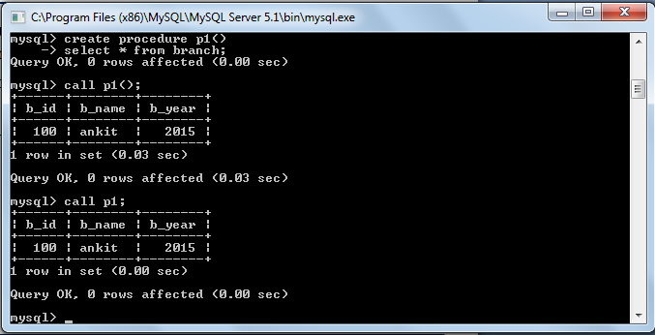

Slide 9
Assigning Values to Variables
You manipulate variable values with the SET statement, which has the following syntax:
SET variable_name = expression
mysql> Delimiter $$
CREATE PROCEDURE example1( )
BEGIN
DECLARE i INTEGER;
SET i=1;
END$$

Slide 10
Stored Procedures - Delimiter
The delimiter is the character or string of characters which is used to complete an SQL statement.
By default we use semicolon (;) as a delimiter. But this causes problem in stored procedure because a procedure can have many statements, and everyone must end with a semicolon.
So for your delimiter, pick a string which is rarely occur within statement or within procedure.
Here we have used double dollar sign i.e. $$.You can use whatever you want.
mysql> DELIMITER $$ ;

Slide 11
BEGIN ... END Compound-Statement Syntax
BEGIN ... END block is used to write compound statements, i.e. when you need more than one statement within stored programs (e.g. stored procedures, functions, triggers, and events). Here is the syntax :
BEGIN
[Statement list]
END
statement_list : It represents one or more statements terminated by a semicolon(;). The statement_list itself is optional, so the empty compound statement BEGIN END is valid.

Slide 12
Variables in Stored Programs
System variables and user-defined variables can be used in stored programs, just as they can be used outside stored-program context.
Stored programs use DECLARE to define local variables, and stored routines (procedures and functions) can be declared to take parameters that communicate values between the routine and its caller.
Declare a Variable :
DECLARE [varname ] DATA-TYPE DEFAULT [default value]
To provide a default value for a variable, include a DEFAULT clause. If the DEFAULT clause is missing, the initial value is NULL.

Slide 13
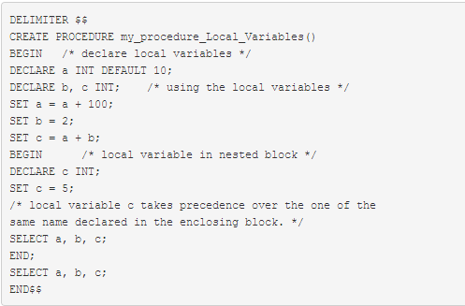
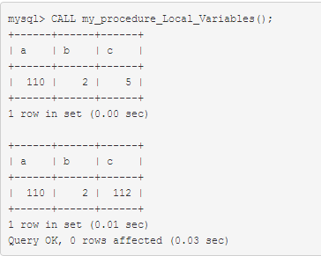
Example : Local variables
Local variables are declared within stored procedures and are only valid within the BEGIN…END block where they are declared.
Local variables can have any SQL data type.

Slide 14
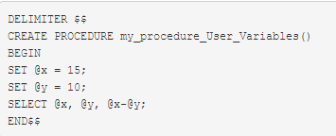
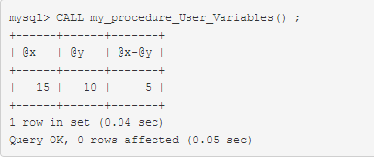
Example : User variables
In MySQL stored procedures, user variables are referenced with an ampersand (@) prefixed to the user variable name (for example, @x and @y).

Slide 15
Stored Procedure Parameters
MySQL, a parameter has one of three modes IN, OUT or INOUT
IN – is the default mode.
When you define an IN parameter in a stored procedure, the calling program has to pass an argument to the stored procedure.

Slide 16
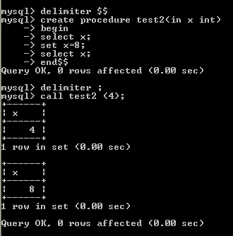

Slide 17
OUT
OUT –
the value of an OUT parameter can be changed inside the stored procedure and its new value is passed back to the calling program.
Notice that the stored procedure cannot access the initial value of the OUT parameter when it starts.
Its initial value is NULL within the procedure.

Slide 18
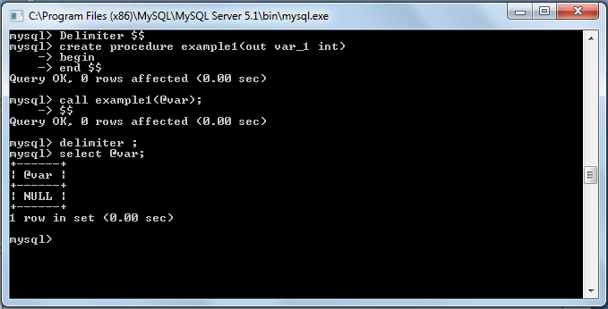
OUT

Slide 19
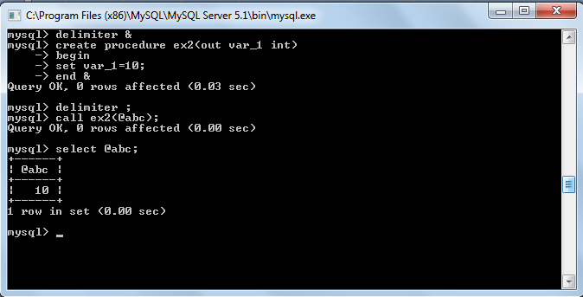
OUT

Slide 20
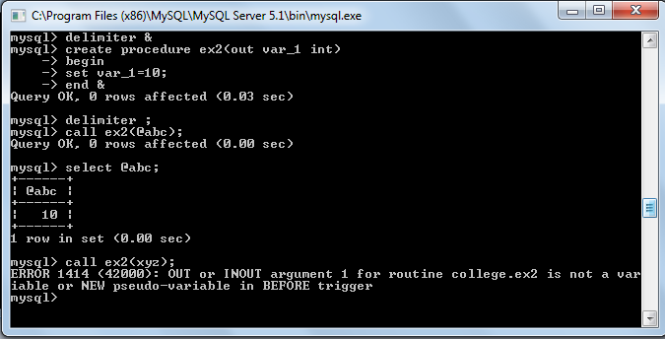
OUT

Slide 21
INOUT
INOUT –
an INOUT parameter is the combination of IN parameter and OUT parameter.
It means that the calling program may pass the argument, and the stored procedure can modify the INOUT parameter and pass the new value back to the calling program.

Slide 22
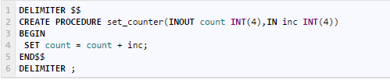

The set_counter stored procedure accepts one INOUT parameter ( count) and one INparameter ( inc).
Inside the stored procedure, we increase the counter ( count) by the value of the inc parameter.

Slide 23
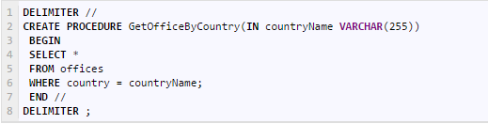
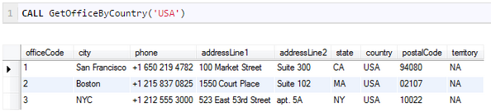
Example(Use of Stored procedure)
The following example illustrates how to use the IN parameter in the GetOfficeByCountry stored procedure that selects offices located in a specified country.
Suppose, you want to get all offices in the USA, you just need to pass a value (USA) to the stored procedure as follows:

Slide 24
MySQL : If Statement
The IF statement implements a basic conditional construct within a stored programs and must be terminated with a semicolon.
There is also an IF() function, which is different from the IF statement.
IF condition THEN statement(s)
[ELSEIF condition THEN statement(s)] ...
[ELSE statement(s)]
END IF
If condition evaluates to true, the corresponding THEN or ELSEIF clause statements(s)executes.
If no condition matches, the ELSE clause statement(s) executes.
Each statement(s) consists of one or more SQL statements; an empty statement(s) is not permitted.

Slide 25
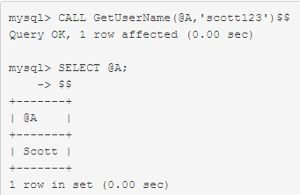
In the following example we pass user_id through IN parameter to get the user name. Within the procedure we have used IF ELSEIF and ELSE statement to get user name against multiple user id. The user name will be stored into INOUT parameter user_name.
CREATE PROCEDURE GetUserName(INOUT user_name varchar(16), IN user_id varchar(16))
BEGIN
IF user_id = "scott123"
THEN
SET user_name = "Scott";
ELSEIF user_id = "ferp6734"
THEN
SET user_name = "Palash";
ELSEIF user_id = "diana094"
THEN
SET user_name = "Diana";
END IF;
END

Slide 26
MySQL : Case Statement
The CASE statement is used to create complex conditional construct within stored programs.
It is terminated with END CASE instead of END.
CASE case_value
WHEN when_value THEN statement_list
[WHEN when_value THEN statement_list] ...
[ELSE statement_list] END CASE
case_value is an expression. - This value is compared to the when_value expression in each WHEN clause until one of them is equal. - When an equal when_value is found, the corresponding THEN clause statement_list executes. - If no when_value is equal, the ELSE clause statement_list executes, if there is one.

Slide 27
MySQL : Case Statement…
CASE
WHEN search_condition THEN statement_list
[WHEN search_condition THEN statement_list] ...
[ELSE statement_list] END CASE
Each WHEN clause search_condition expression is evaluated until one is true, at which point its corresponding THEN clause statement_list executes. - If no search_condition is equal, the ELSE clause statement_list executes, if there is one. - Each statement_list consists of one or more SQL statements; an empty statement_list is not permitted.

Slide 28
MySQL : Case Statement…
Count the number of employees with following conditions :
- MIN_SALARY > 10000 - MIN_SALARY < 10000 - MIN_SALARY = 10000
Write procedure for above?
CREATE PROCEDURE my_proc_CASE (INOUT no_employees INT, IN salary INT)
BEGIN
CASE
WHEN (salary>10000)
THEN (SELECT COUNT(job_id) INTO no_employees FROM jobs WHERE min_salary>10000);
WHEN (salary<10000)
THEN (SELECT COUNT(job_id) INTO no_employees FROM jobs WHERE min_salary<10000);
ELSE (SELECT COUNT(job_id) INTO no_employees FROM jobs WHERE min_salary=10000);
END CASE;
END

Slide 29
MySQL : ITERATE,LEAVE Statement
ITERATE means "start the loop again". ITERATE can appear only within LOOP, REPEAT, and WHILE statements.
ITERATE Syntax :
ITERATE label
LEAVE statement is used to exit the flow control construct that has the given label.
If the label is for the outermost stored program block, LEAVE exits the program.
LEAVE can be used within BEGIN ... END or loop constructs (LOOP, REPEAT, WHILE).
LEAVE Syntax :
LEAVE label

Slide 30
Example
CREATE PROCEDURE doiterate(p1 INT)
BEGIN
label1: LOOP
SET p1 = p1 + 1;
IF p1 < 10 THEN
ITERATE label1;
END IF;
LEAVE label1;
END LOOP label1;
SET @x = p1;
END;

Slide 31
MySQL : LOOP Statement
LOOP is used to create repeated execution of the statement list.
LOOP syntax :
[begin_label:]
LOOP
statement_list
END LOOP
[end_label]
Statement_list consists one or more statements, each statement terminated by a semicolon (;).
the statements within the loop are repeated until the loop is terminated.
Usually LEAVE statement is used to exit the loop construct.

Slide 32
In the following procedure rows will be inserted in 'number' table until x is less than num (number supplied by the user through IN parameter). A random number will be stored every time.
CREATE PROCEDURE my_proc_LOOP2 (IN num INT)
BEGIN
DECLARE x INT;
SET x = 0;
loop_label: LOOP
INSERT INTO t1 VALUES (rand());
SET x = x + 1;
IF x >= num
THEN
LEAVE loop_label;
END IF;
END LOOP;
END

Slide 33
MySQL : REPEAT Statement
The REPEAT statement executes the statement(s) repeatedly as long as the condition is true. The condition is checked every time at the end of the statements.
[begin_label:]
REPEAT
statement_list
UNTIL search_condition
END
REPEAT
[end_label]

Slide 34
Example
mysql> delimiter //
mysql> CREATE PROCEDURE dorepeat(p1 INT)
-> BEGIN
-> SET @x = 0;
-> REPEAT
-> SET @x = @x + 1;
-> UNTIL @x > p1 END REPEAT;
-> END
-> //
Query OK, 0 rows affected (0.00 sec)
mysql> CALL dorepeat(1000)//
Query OK, 0 rows affected (0.00 sec)
mysql> SELECT @x//
+------+
| @x |
+------+
| 1001 |
+------+
1 row in set (0.00 sec)

Slide 35
MySQL : WHILE Statement
The WHILE statement executes the statement(s) as long as the condition is true. The condition is checked every time at the beginning of the loop.
Each statement is terminated by a semicolon (;).
[begin_label:] WHILE search_condition DO
statement_list
END WHILE [end_label]

Slide 36
Odd numbers are numbers that cannot be divided exactly by 2. In the following procedure an user passes a number through IN parameter and make a sum of odd numbers between 1 and that particular number.
CREATE PROCEDURE my_proc_WHILE(IN n INT)
BEGIN
SET @sum = 0;
SET @x = 1;
WHILE @x<n
DO IF mod(@x, 2) <> 0 THEN
SET @sum = @sum + @x;
END IF;
SET @x = @x + 1;
END WHILE;
END

Slide 37
Is given procedure execute successfully ?
mysql> CREATE TABLE t1 (s1 INT, PRIMARY KEY (s1));
mysql> CREATE PROCEDURE handlerdemo ()
-> BEGIN
-> SET @x = 1;
-> INSERT INTO t1 VALUES (1);
-> SET @x = 2;
-> INSERT INTO t1 VALUES (1);
-> SET @x = 3;
-> END;

Slide 38
mysql> CREATE TABLE t1 (s1 INT, PRIMARY KEY (s1));
mysql> CREATE PROCEDURE handlerdemo3 ()
-> BEGIN
-> SET @x = 1;
-> INSERT INTO t1 VALUES (1);
-> SET @x = 2;
-> INSERT INTO t1 VALUES (1);
-> SET @x = 3;
-> END;

